Slide 1
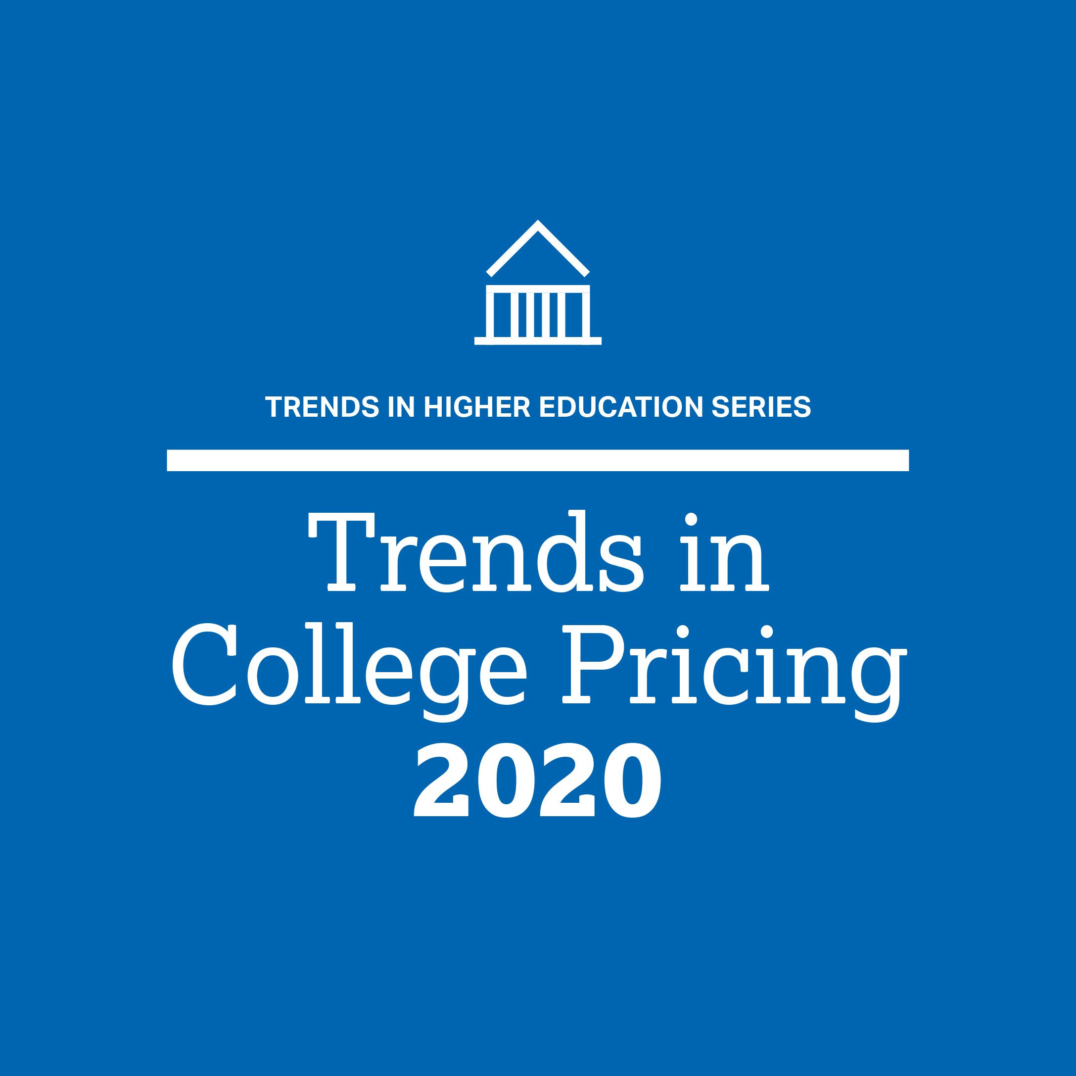
Trends in College Pricing 2020
Trends in Higher Education Series
October 2020
research.collegeboard.org/trends

Slide 2
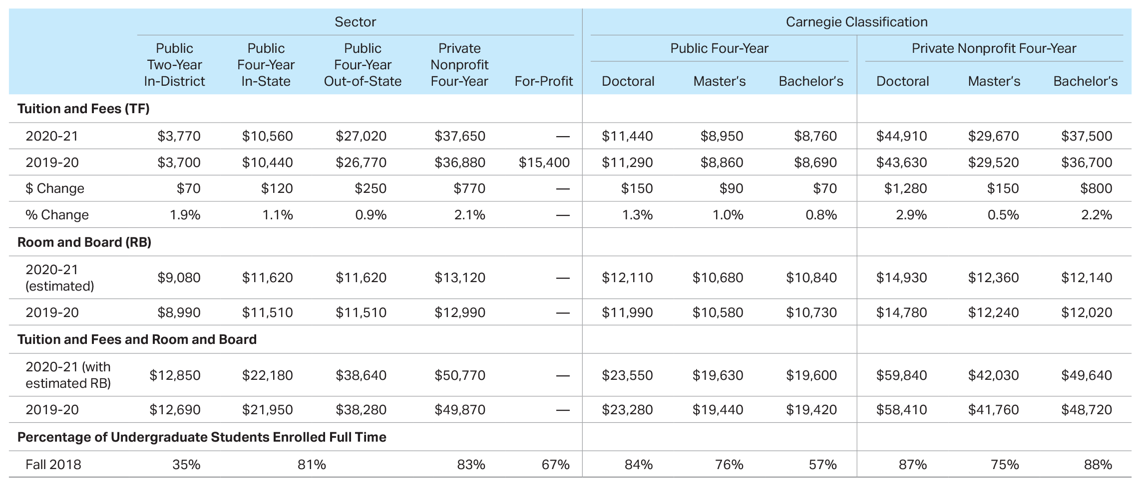
Average Published Charges (Enrollment-Weighted) for Full-Time Undergraduates, 2019-20 and 2020-21
Source: The College Board, Trends in College Pricing and Student Aid 2020, Table CP-1.

Slide 3
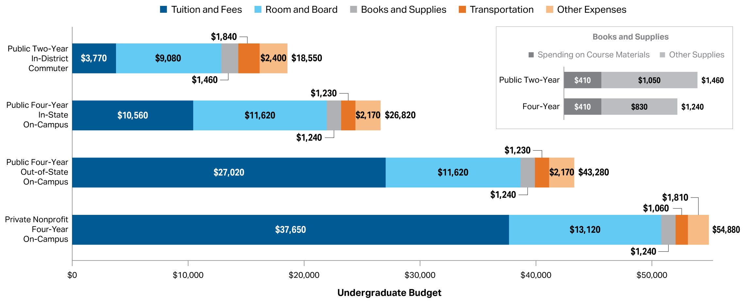
Average Estimated Full-Time Undergraduate Budgets (Enrollment-Weighted) by Sector, 2020-21
Source: The College Board, Trends in College Pricing and Student Aid 2020, Figure CP-1.

Slide 4
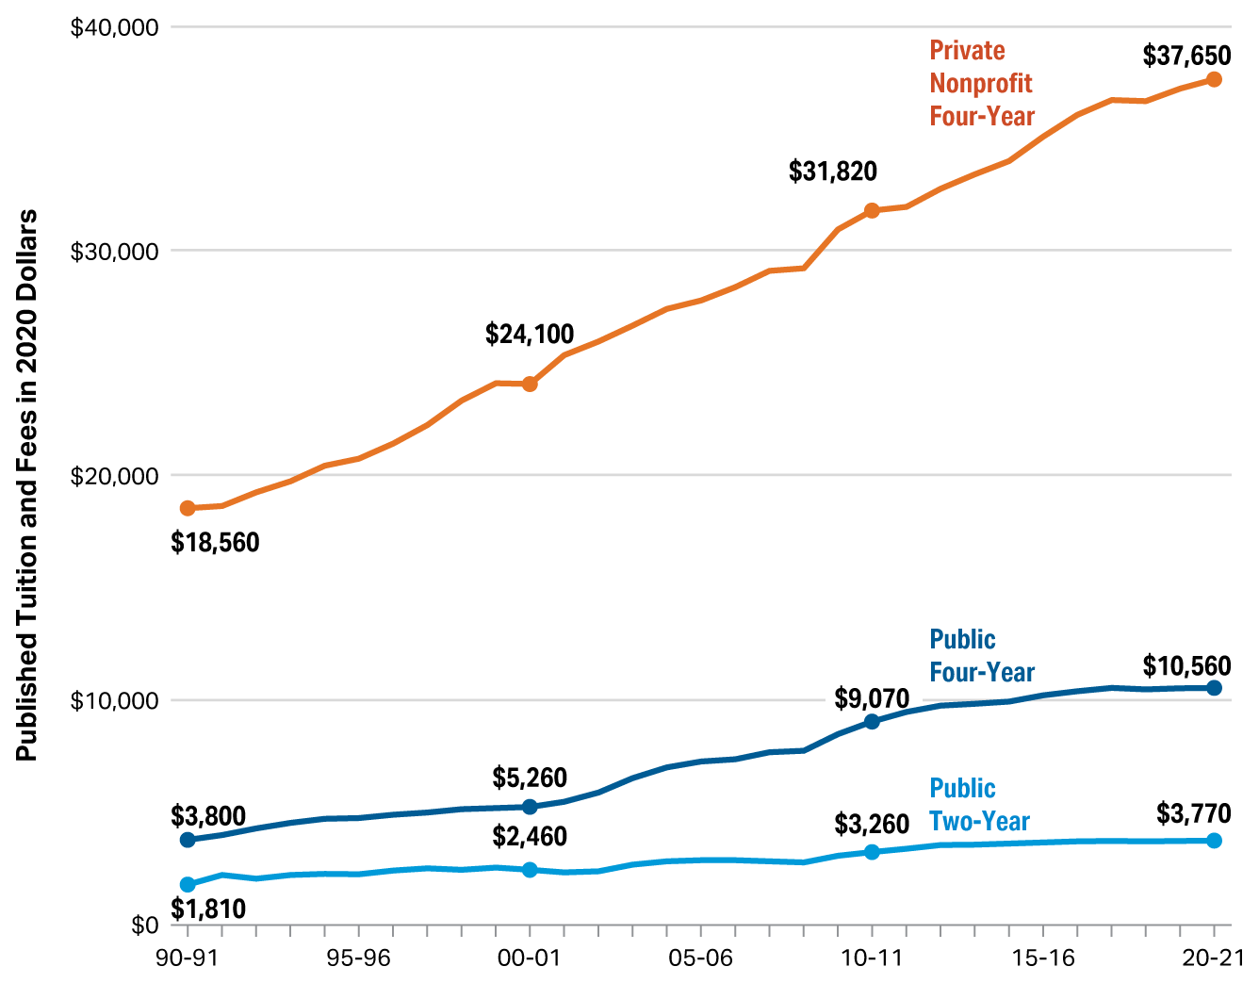
Average Published Tuition and Fees in 2020 Dollars by Sector, 1990-91 to 2020-21
Source: The College Board, Trends in College Pricing and Student Aid 2020, Figure CP-2.

Slide 5
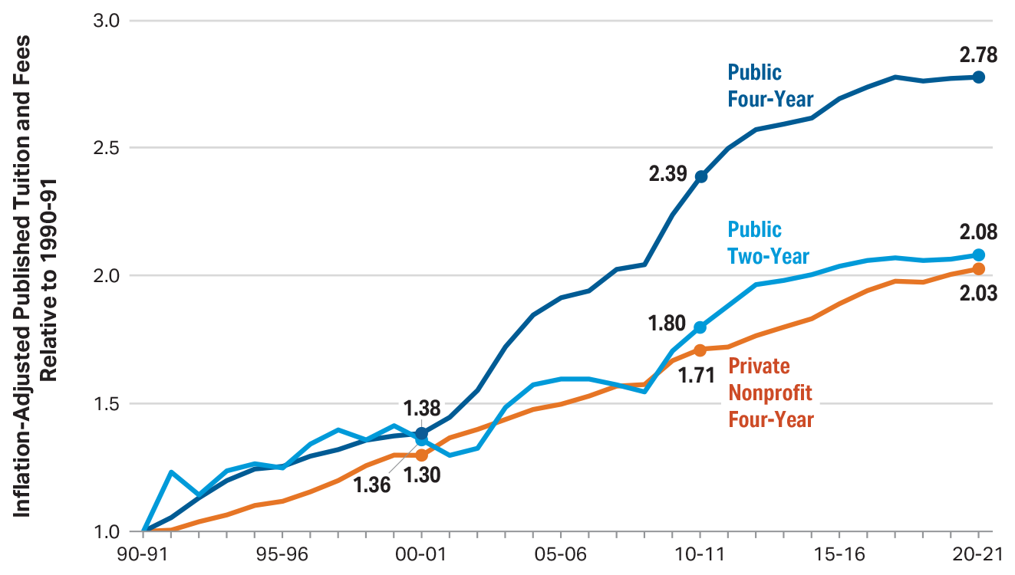
Inflation-Adjusted Published Tuition and Fees Relative to 1990-91, 1990-91 to 2020-21 (1990-91 = 1.0)
Source: The College Board, Trends in College Pricing and Student Aid 2020, Figure CP-3.

Slide 6
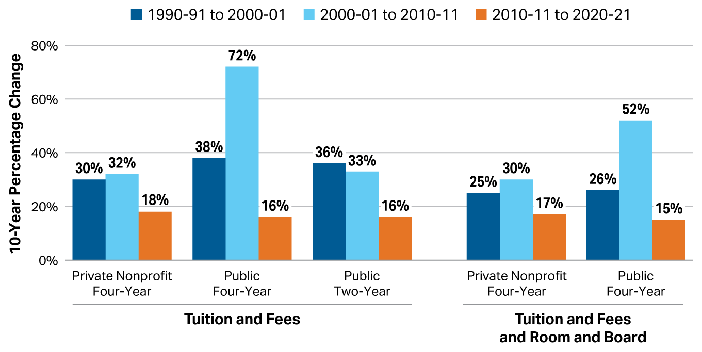
Ten-Year Percentage Changes in Inflation-Adjusted Published Prices by Decade, 1990-91 to 2020-21
Source: The College Board, Trends in College Pricing and Student Aid 2020, Figure CP-4.

Slide 7
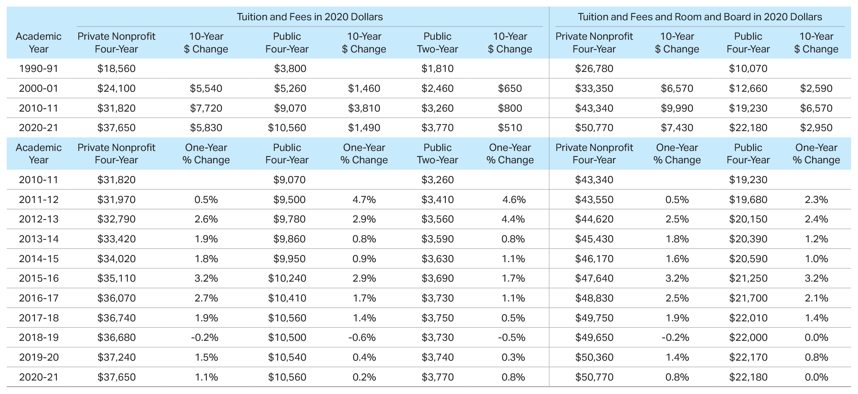
Average Tuition and Fees and Room and Board in 2020 Dollars, 1990-91 to 2020-21, Selected Years
Source: The College Board, Trends in College Pricing and Student Aid 2020, Table CP-2.

Slide 8
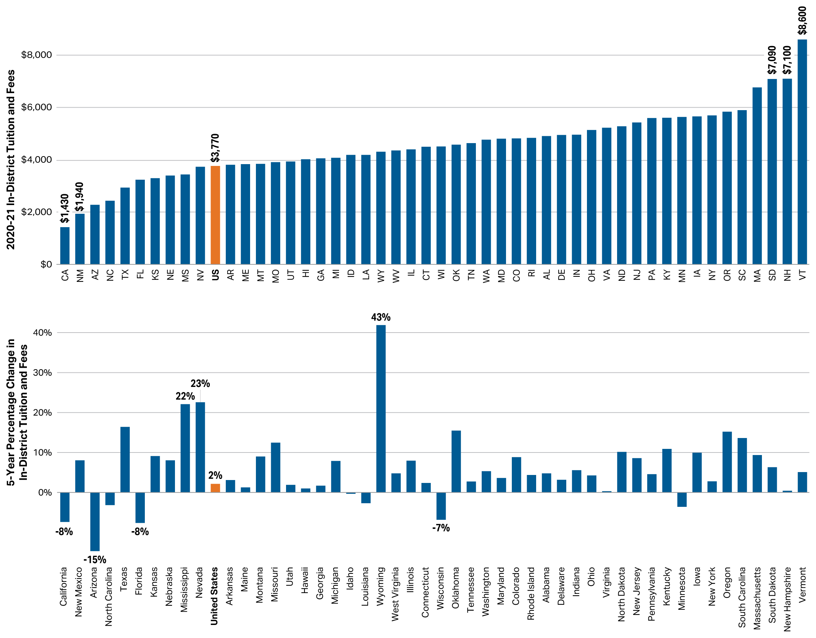
Average 2020-21 In-District Tuition and Fees at Public Two-Year Institutions and Five-Year Percentage Changes in Inflation-Adjusted In-District Tuition and Fees, by State
Source: The College Board, Trends in College Pricing and Student Aid 2020, Figure CP-5.

Slide 9
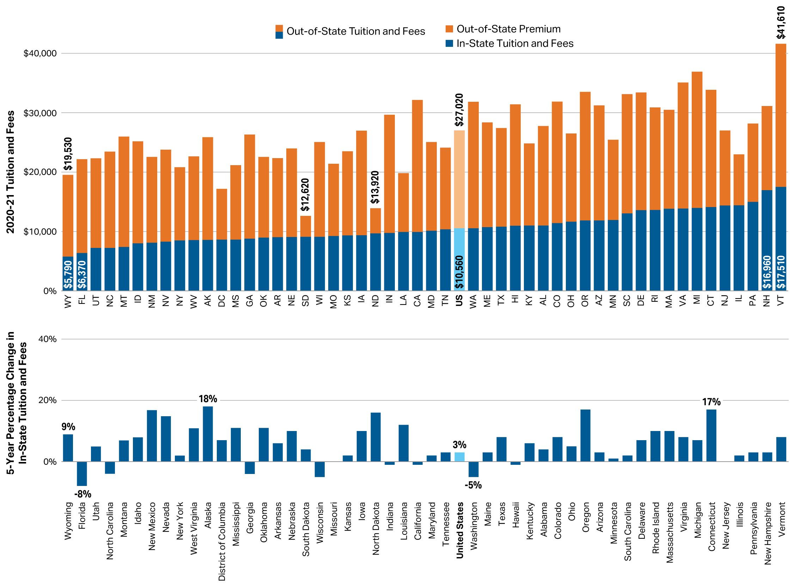
Average 2020-21 Tuition and Fees at Public Four-Year Institutions and Five-Year Percentage Changes in Inflation-Adjusted In-State Tuition and Fees, by State
Source: The College Board, Trends in College Pricing and Student Aid 2020, Figure CP-6.

Slide 10
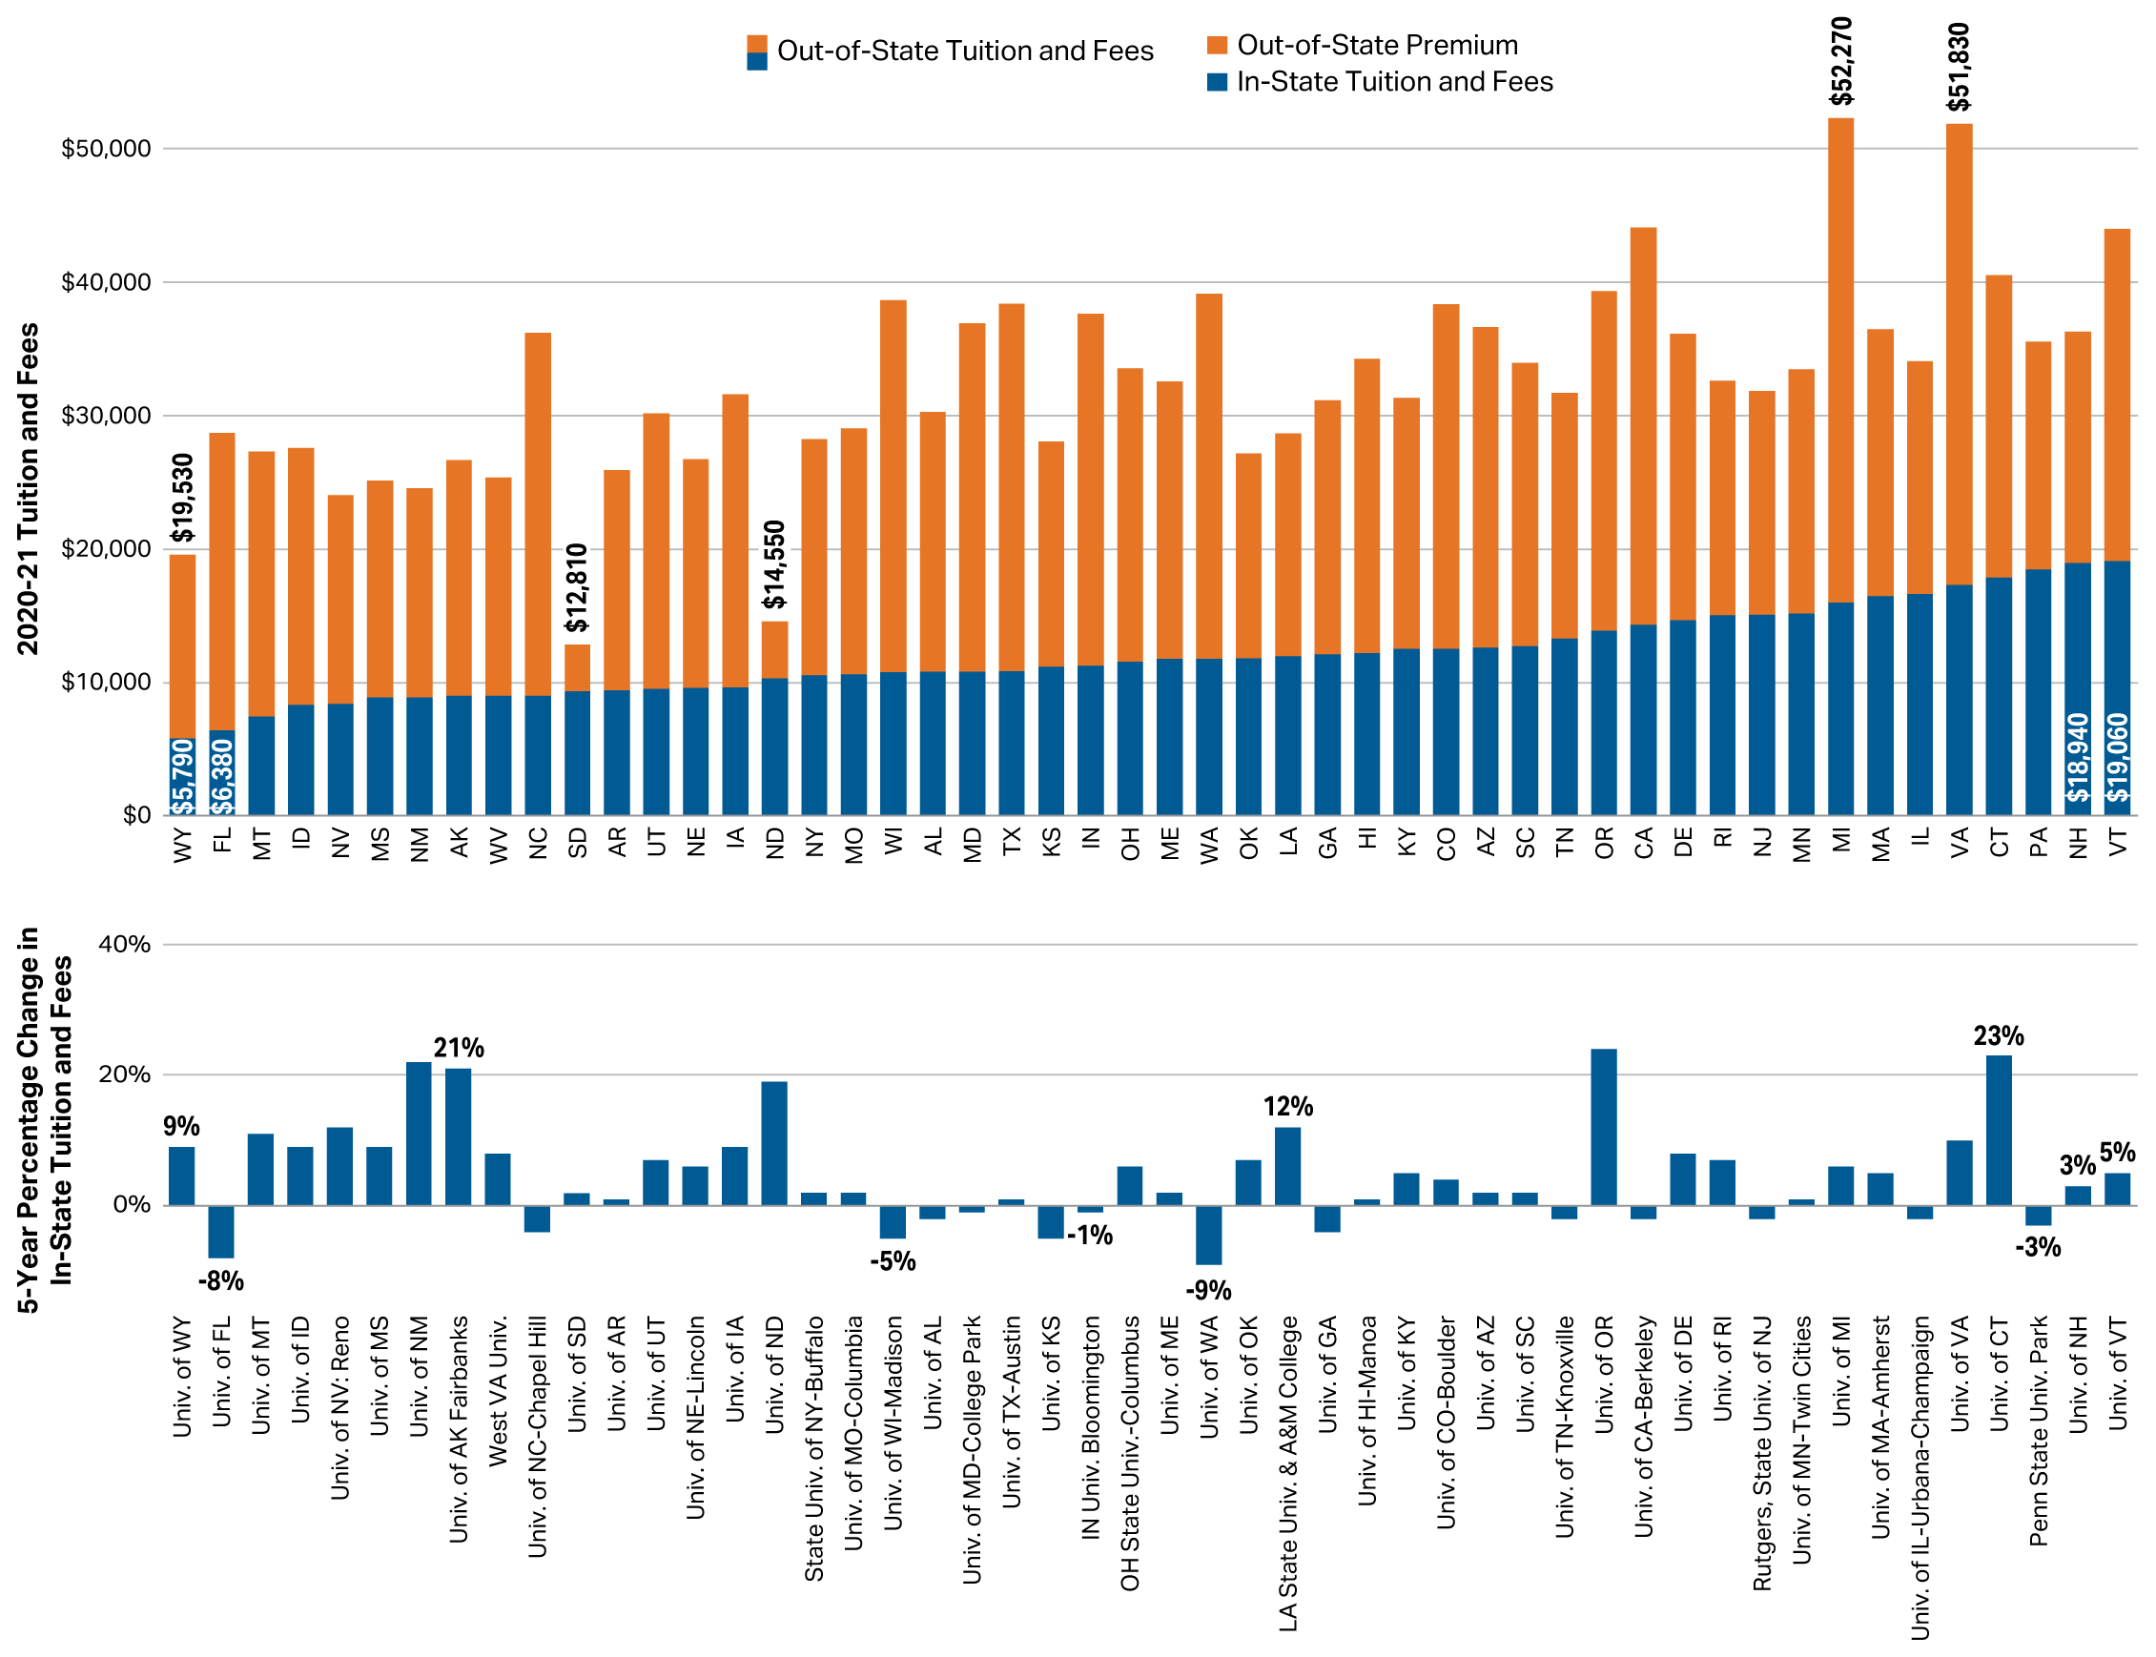
2020-21 Tuition and Fees at Flagship Universities and Five-Year Percentage Changes in Inflation-Adjusted In-State Tuition and Fees
Source: The College Board, Trends in College Pricing and Student Aid 2020, Figure CP-7.

Slide 11
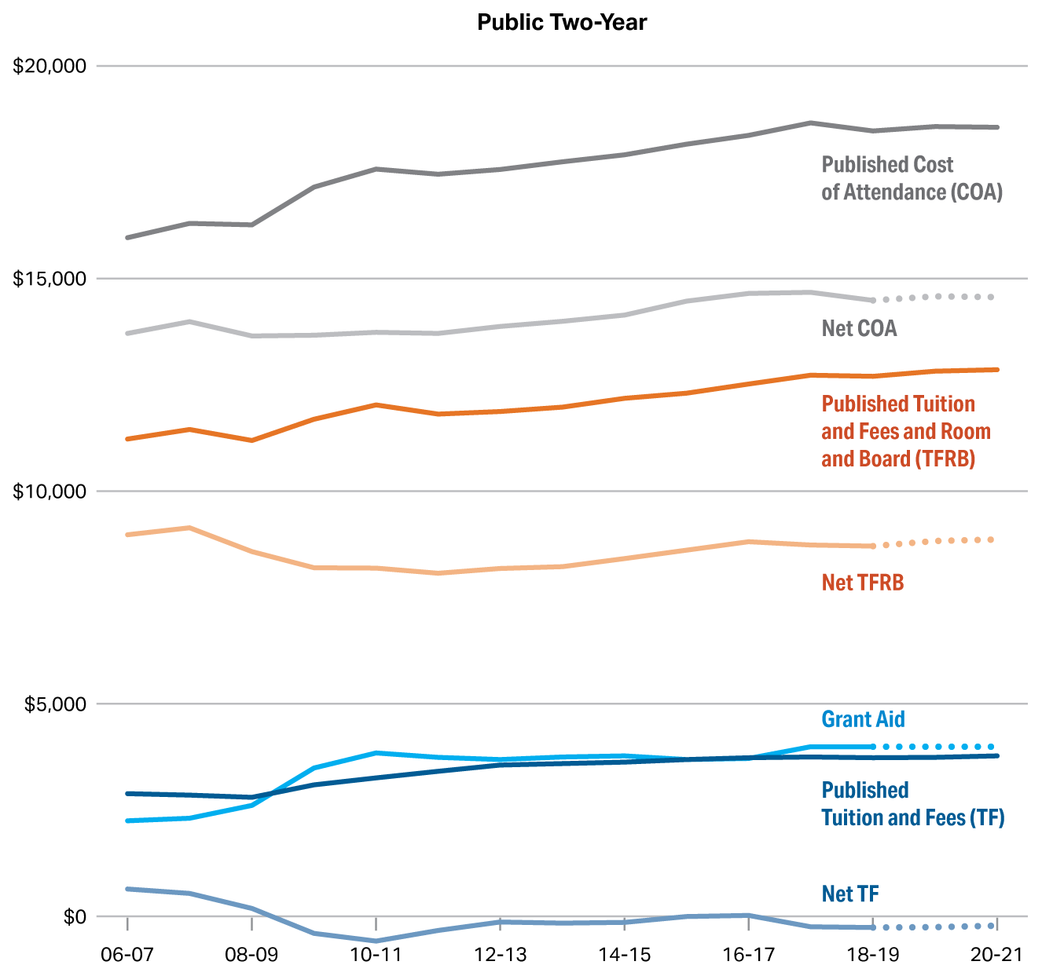
Average Published and Net Prices in 2020 Dollars, First-Time Full-Time In-District Undergraduate Students at Public Two-Year Institutions, 2006-07 to 2020-21
Source: The College Board, Trends in College Pricing and Student Aid 2020, Figure CP-8.

Slide 12
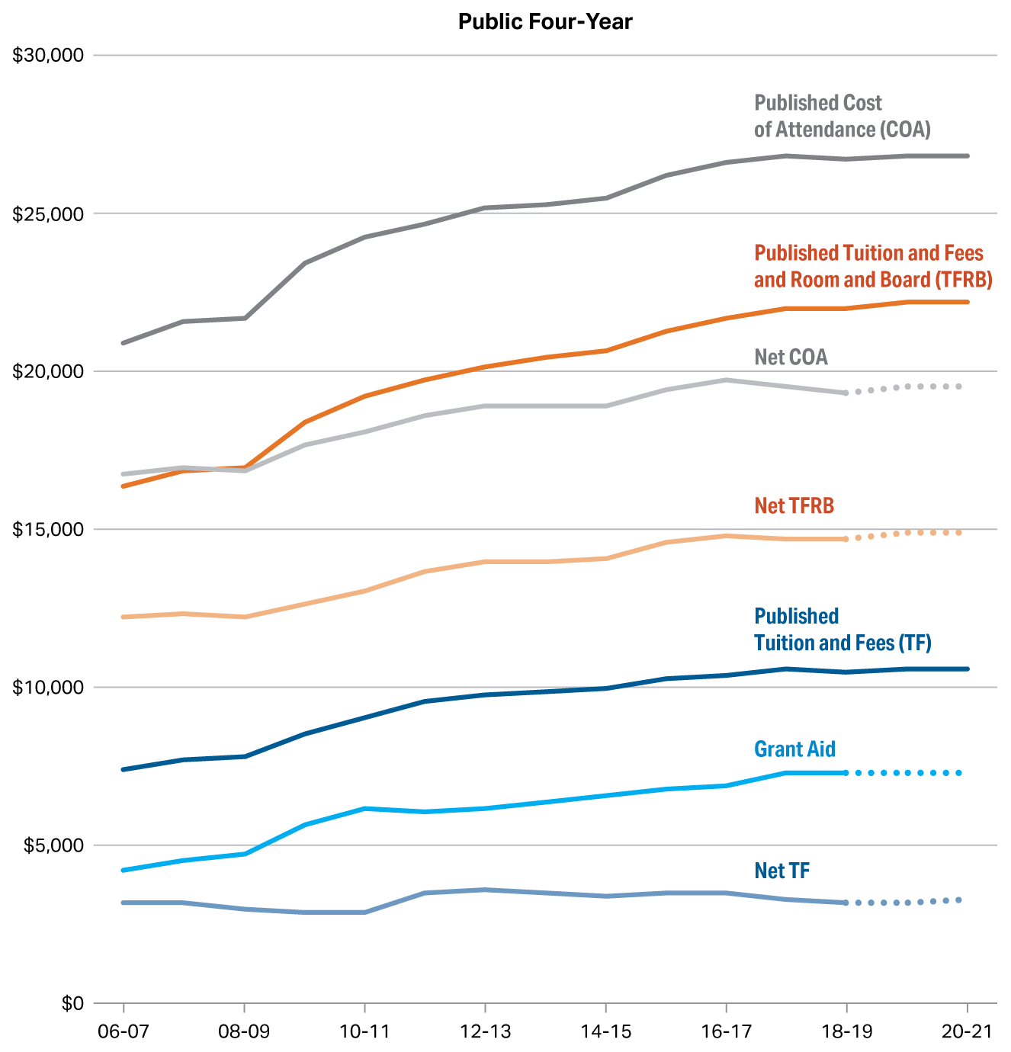
Average Published and Net Prices in 2020 Dollars, First-Time Full-Time In-State Undergraduate Students at Public Four-Year Institutions, 2006-07 to 2020-21
Source: The College Board, Trends in College Pricing and Student Aid 2020, Figure CP-9.

Slide 13
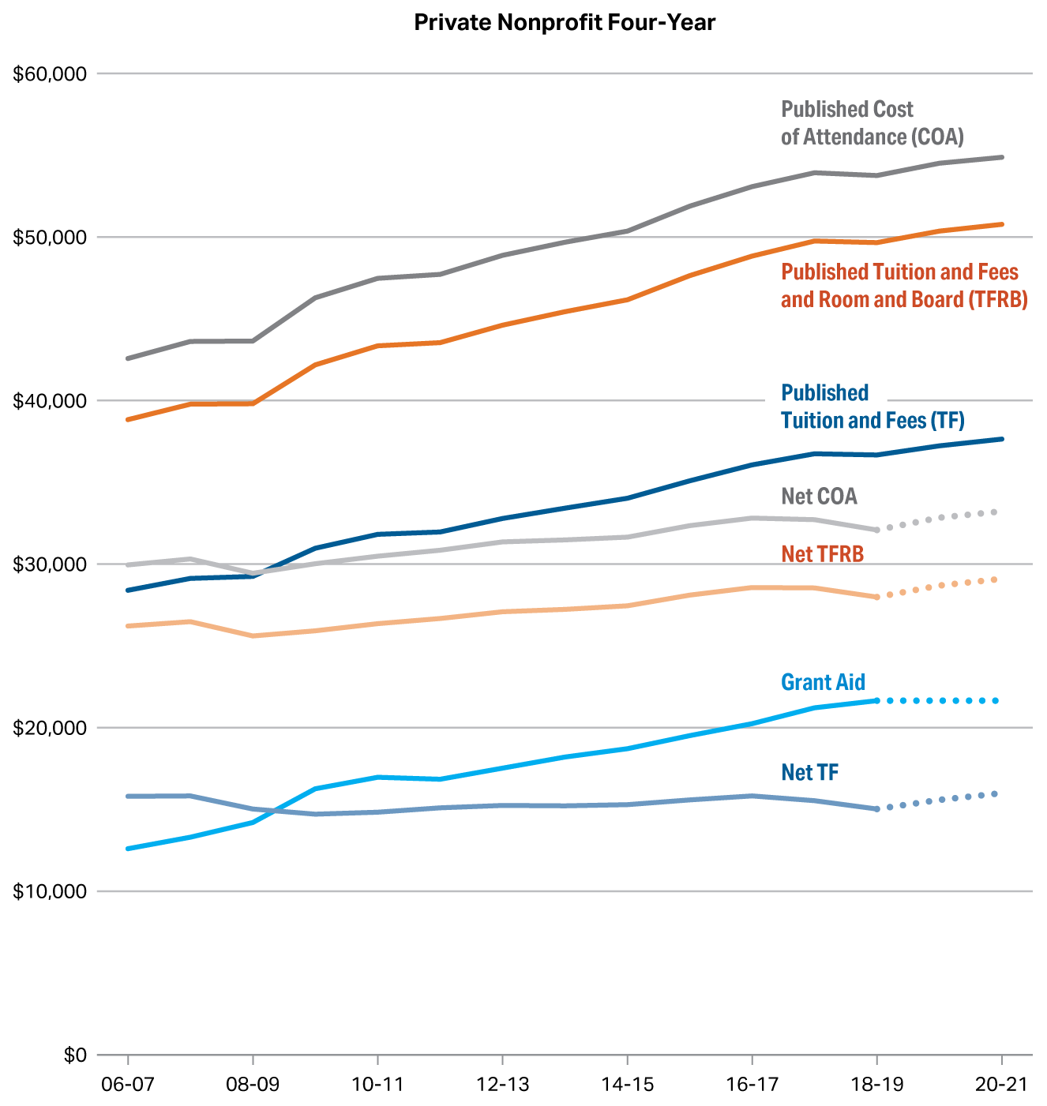
Average Published and Net Prices in 2020 Dollars, First-Time Full-Time Undergraduate Students at Private Nonprofit Four-Year Institutions, 2006-07 to 2020-21
Source: The College Board, Trends in College Pricing and Student Aid 2020, Figure CP-10.

Slide 14
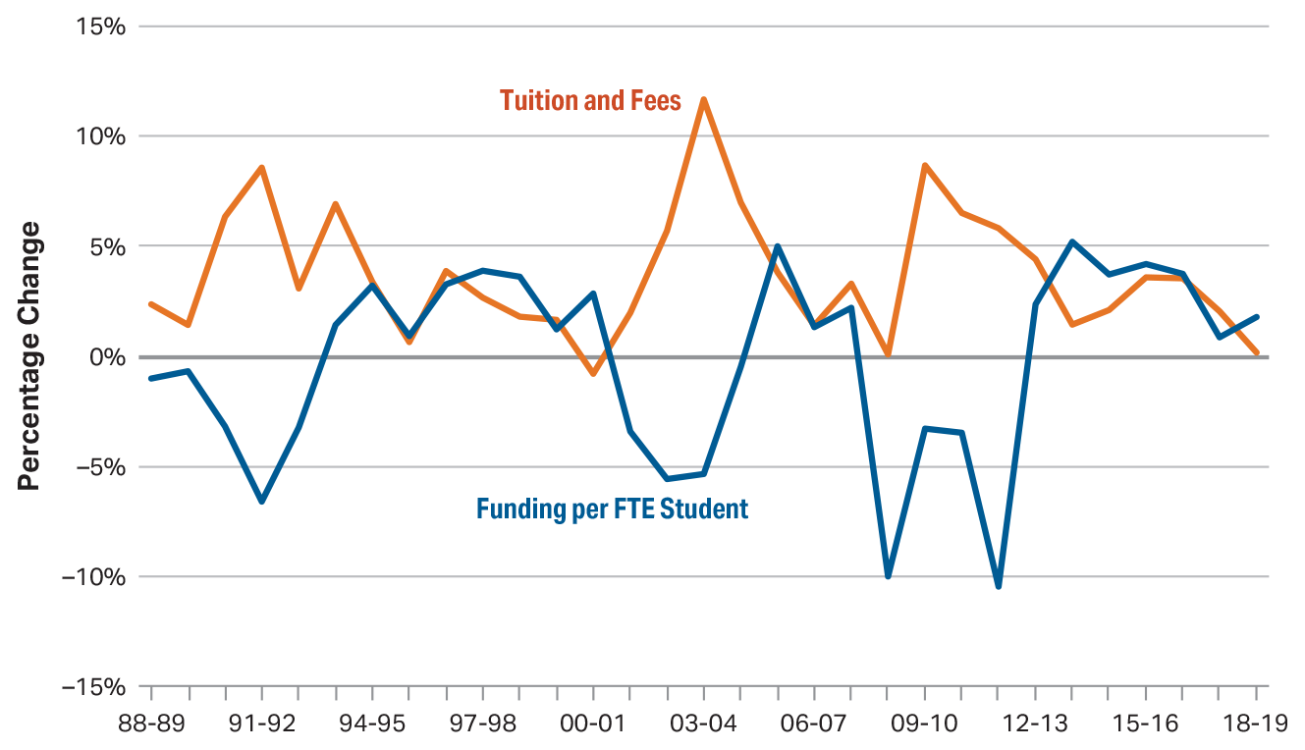
Annual Percentage Changes in Inflation-Adjusted Per-Student State and Local Funding for Higher Education and in Tuition and Fees at Public Institutions, 1988-89 to 2018-19
Source: The College Board, Trends in College Pricing and Student Aid 2020, Figure CP-11A.

Slide 15
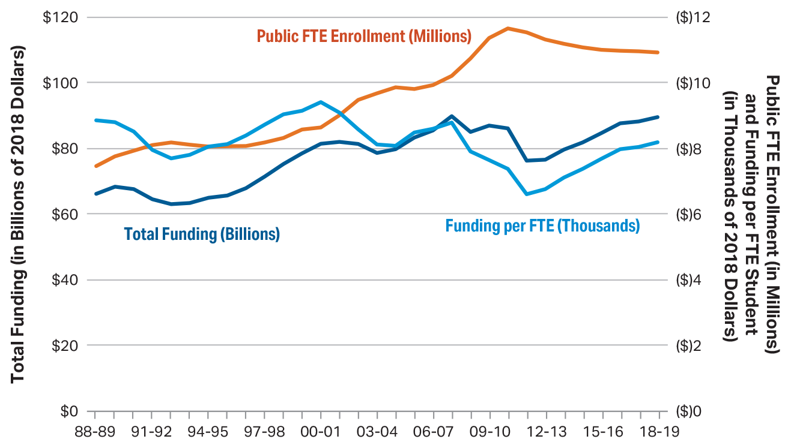
Total and Per-Student State and Local Funding for Higher Education in 2018 Dollars and Public FTE Enrollment, 1988-89 to 2018-19
Source: The College Board, Trends in College Pricing and Student Aid 2020, Figure CP-11B.

Slide 16
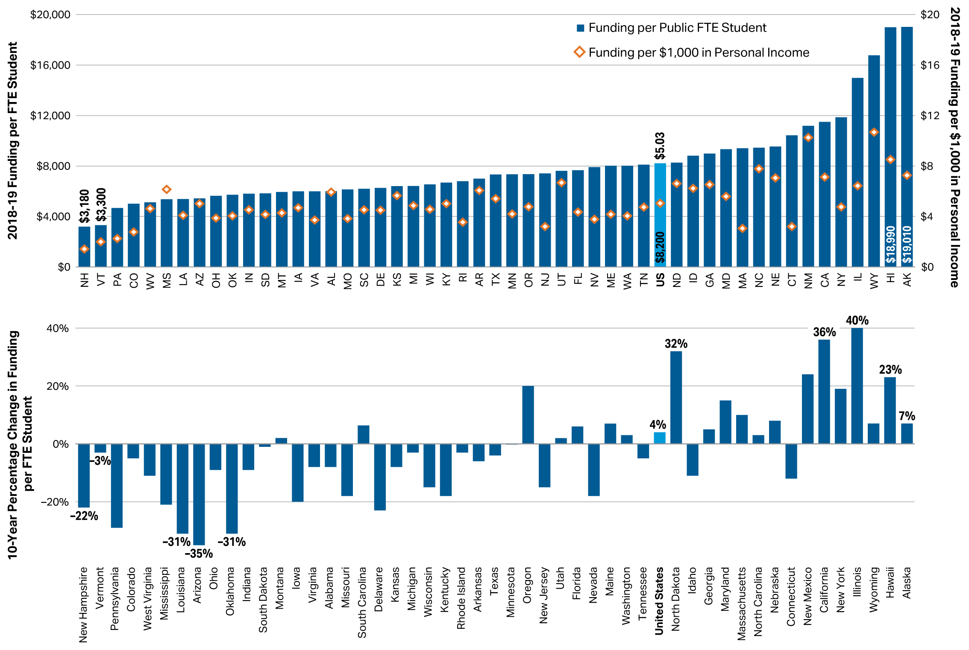
2018-19 State and Local Funding for Higher Education per Student and per $1,000 in Personal Income and 10-Year Percentage Change in Inflation-Adjusted Funding per Student, by State
Source: The College Board, Trends in College Pricing and Student Aid 2020, Figure CP-12.

Slide 17
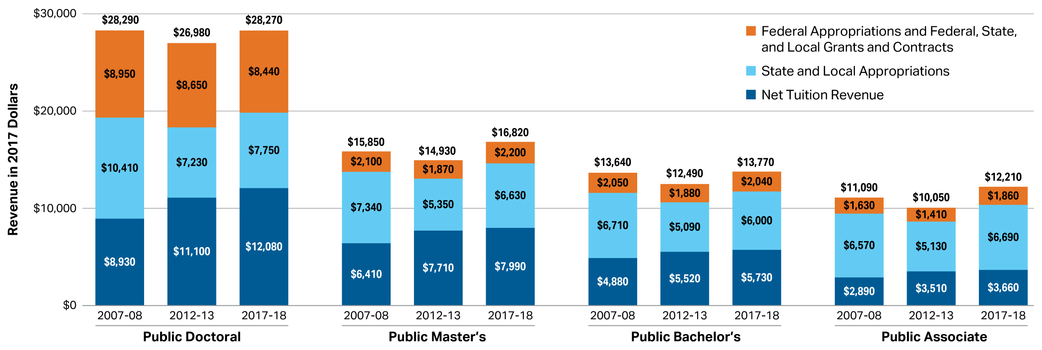
Institutional Revenues per Full-Time Equivalent (FTE) Student in 2017 Dollars at Public Institutions, 2007-08, 2012-13, and 2017-18
Source: The College Board, Trends in College Pricing and Student Aid 2020, Figure CP-13.

Slide 18
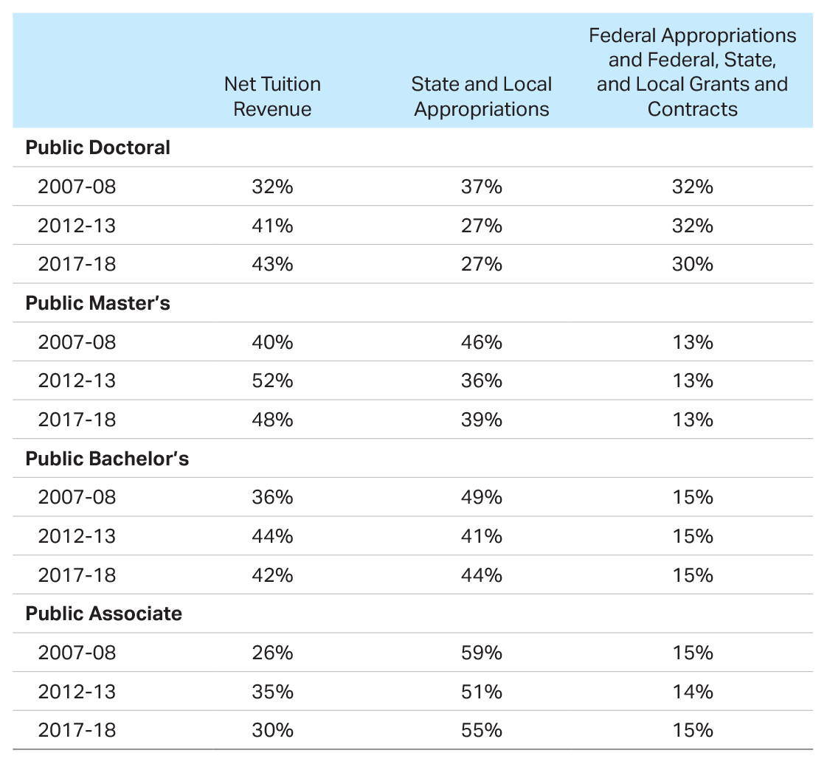
Percentage of Institutional Revenues from Various Sources
Source: The College Board, Trends in College Pricing and Student Aid 2020, Page 22.

Slide 19
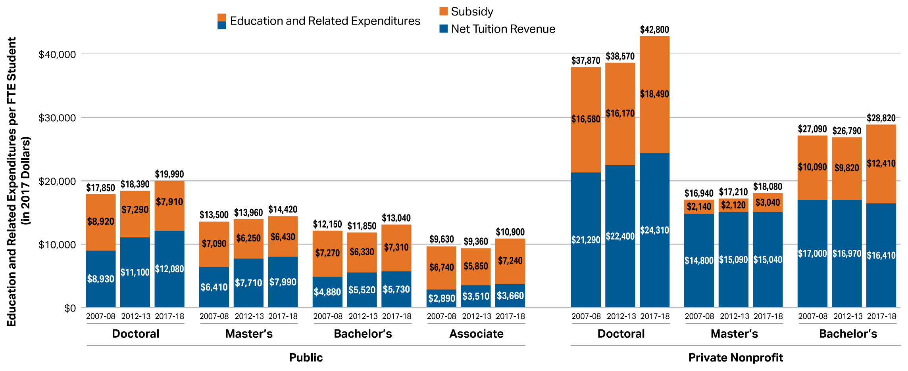
Net Tuition Revenues, Subsidies, and Education and Related Expenditures per Full-Time Equivalent (FTE) Student in 2017 Dollars, 2007-08, 2012-13, and 2017-18
Source: The College Board, Trends in College Pricing and Student Aid 2020, Figure CP-14.

Slide 20
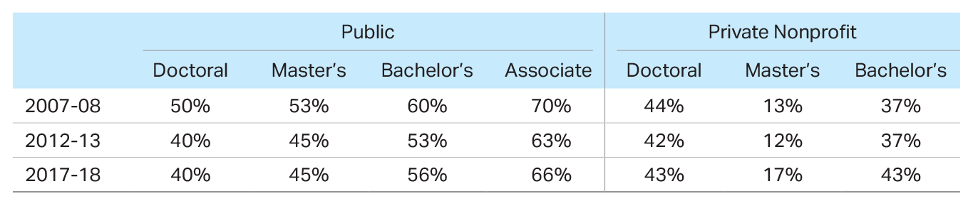
Subsidy as a Percentage of Education and Related Expenditures
Source: The College Board, Trends in College Pricing and Student Aid 2020, Page 23.

Slide 21
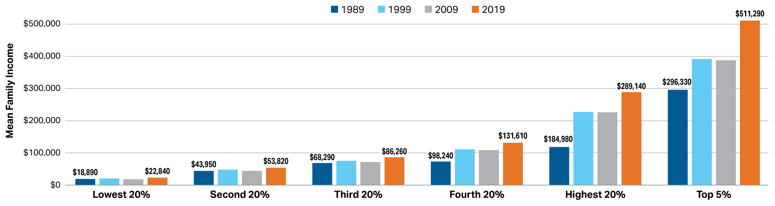
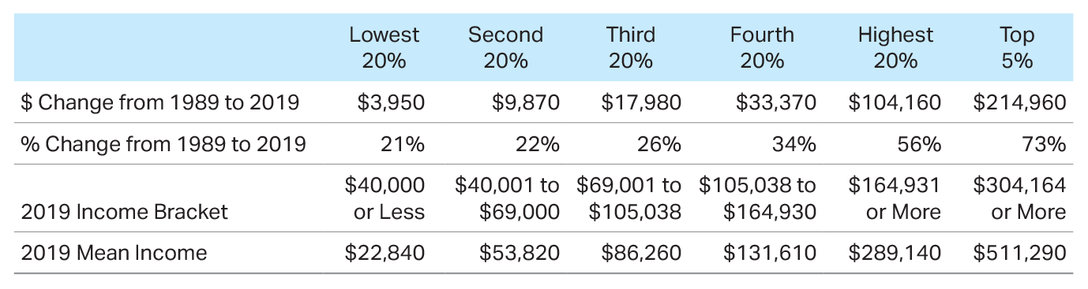
Mean Family Income in 2019 Dollars by Quintile, 1989, 1999, 2009, and 2019
Source: The College Board, Trends in College Pricing and Student Aid 2020, Figure CP-15A.

Slide 22
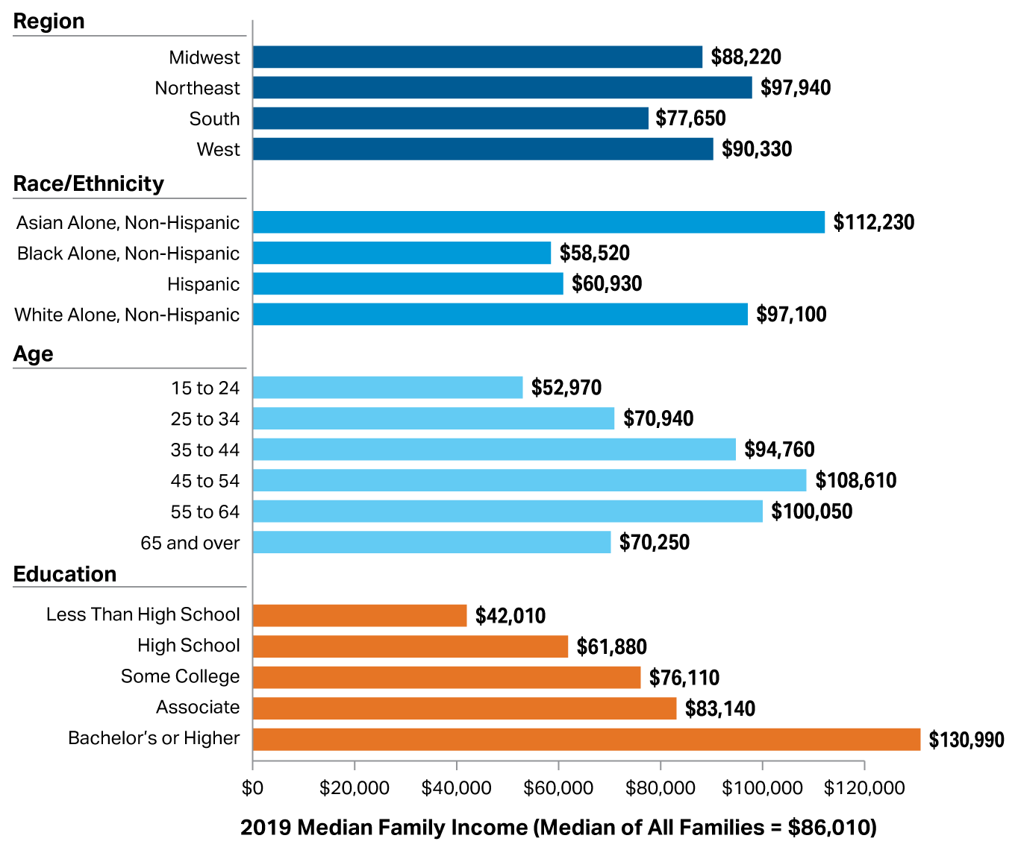
Median Family Income by Selected Characteristics, 2019
Source: The College Board, Trends in College Pricing and Student Aid 2020, Figure CP-15B.

Slide 23
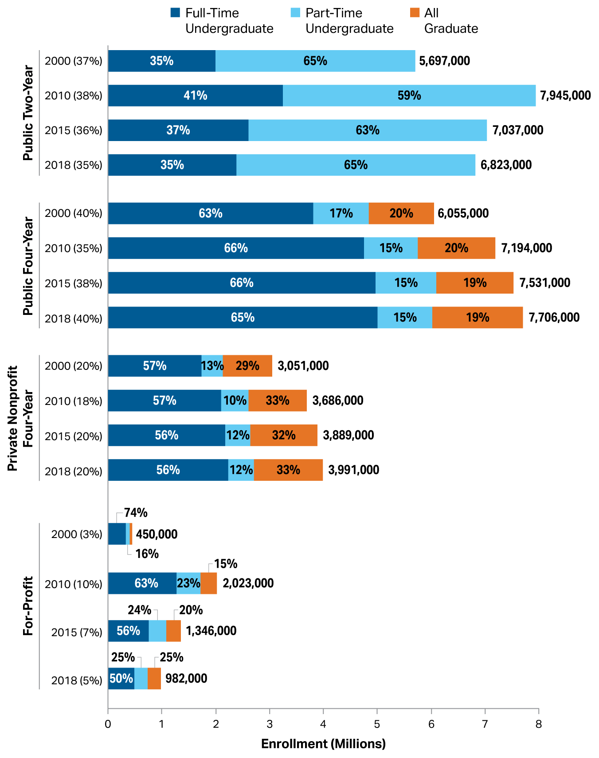
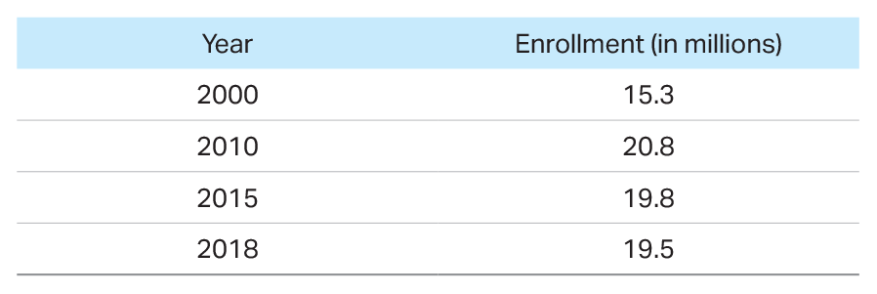
Postsecondary Fall Enrollment by Attendance Status and Level of Enrollment (with Percentage of All Students Enrolled in Each Sector), 2000 to 2018, Selected Years
Source: The College Board, Trends in College Pricing and Student Aid 2020, Figure CP-16.

Slide 24
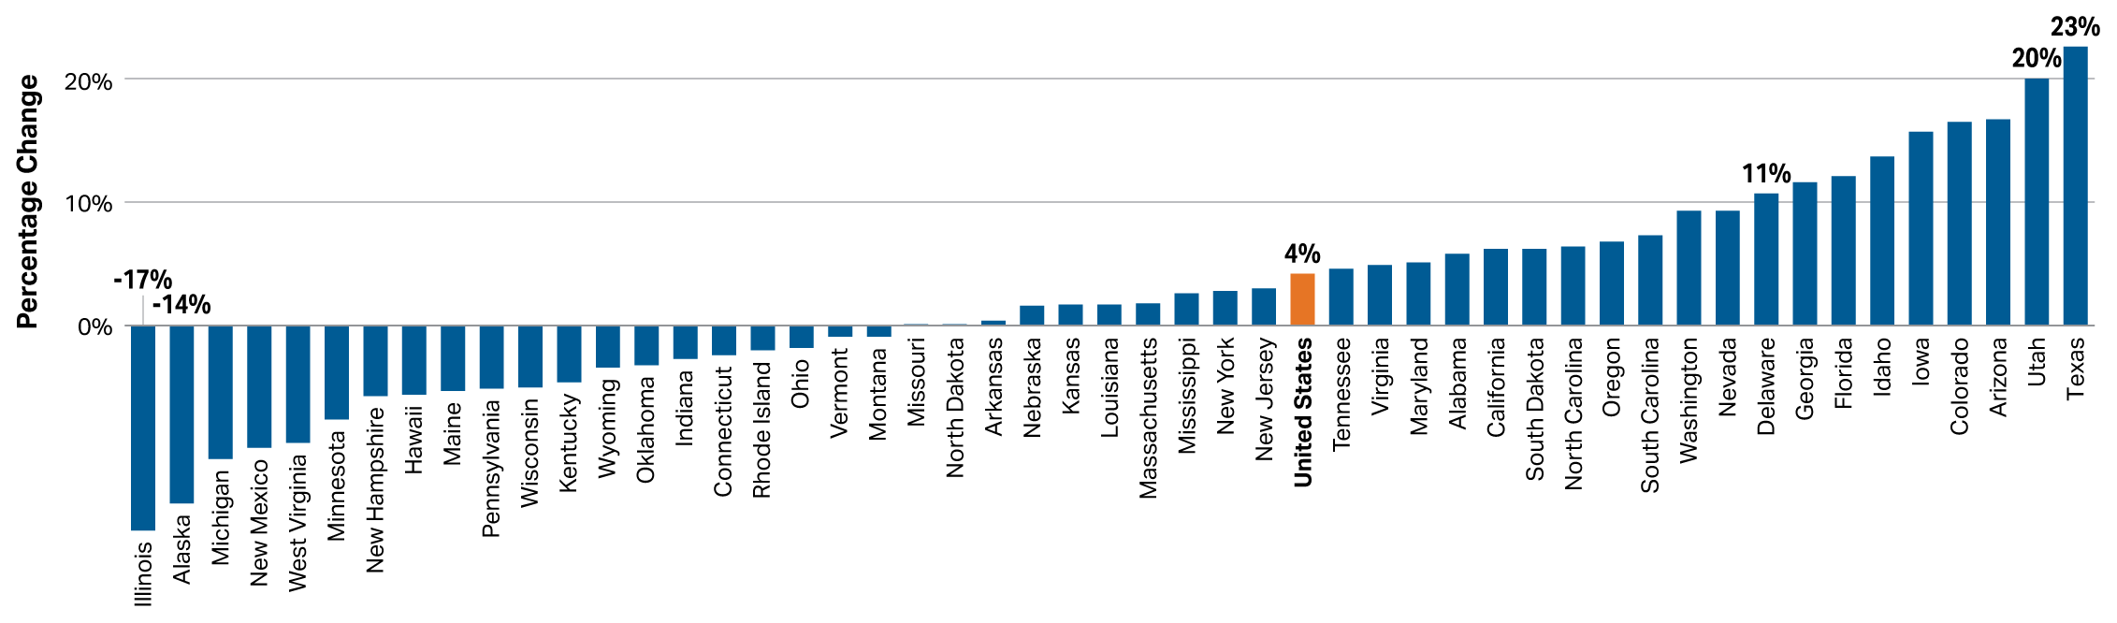
Percentage Change in Full-Time Equivalent (FTE) Enrollment in Public Institutions by State, Fall 2008 to Fall 2018
Source: The College Board, Trends in College Pricing and Student Aid 2020, Figure CP-17A.

Slide 25
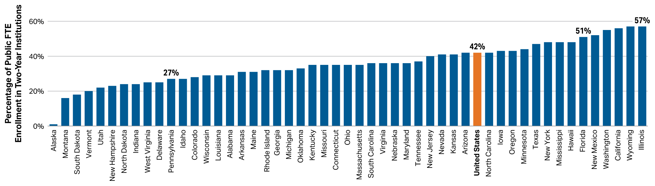
Percentage of All Public Full-Time Equivalent (FTE) Undergraduate Enrollment in Two-Year Institutions by State, Fall 2018
Source: The College Board, Trends in College Pricing and Student Aid 2020, Figure CP-17B.

Slide 26
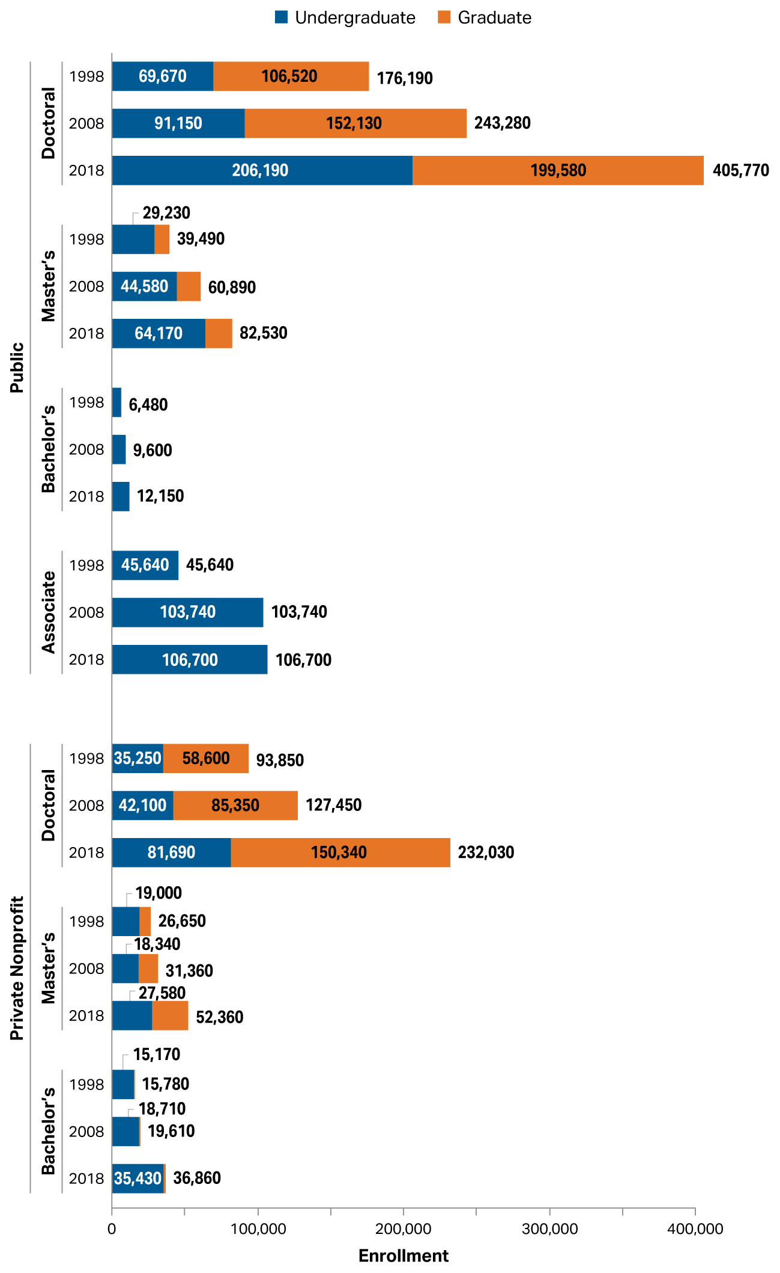
Total Number of Undergraduate and Graduate Students Who Were Not U.S. Citizens or Permanent Residents, by Institution Type, 1998, 2008, and 2018
Source: The College Board, Trends in College Pricing and Student Aid 2020, Figure CP-18.

Slide 27
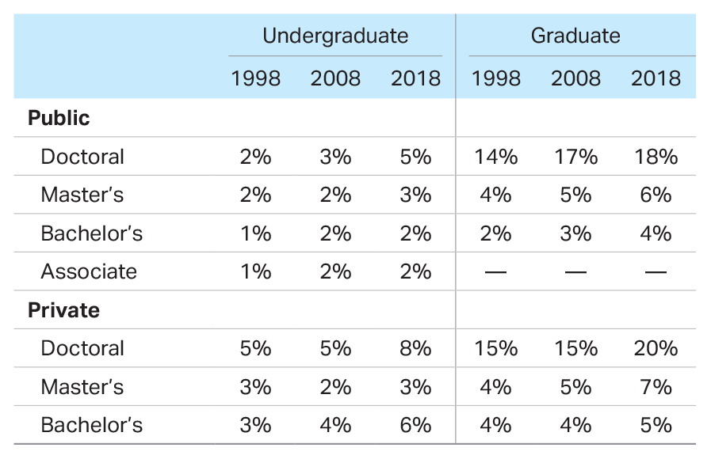
Percentage of Undergraduate and Graduate Students Who Were Not U.S. Citizens or Permanent Residents, by Institution Type, 1998, 2008, and 2018
Source: The College Board, Trends in College Pricing and Student Aid 2020, page 27.

Slide 28
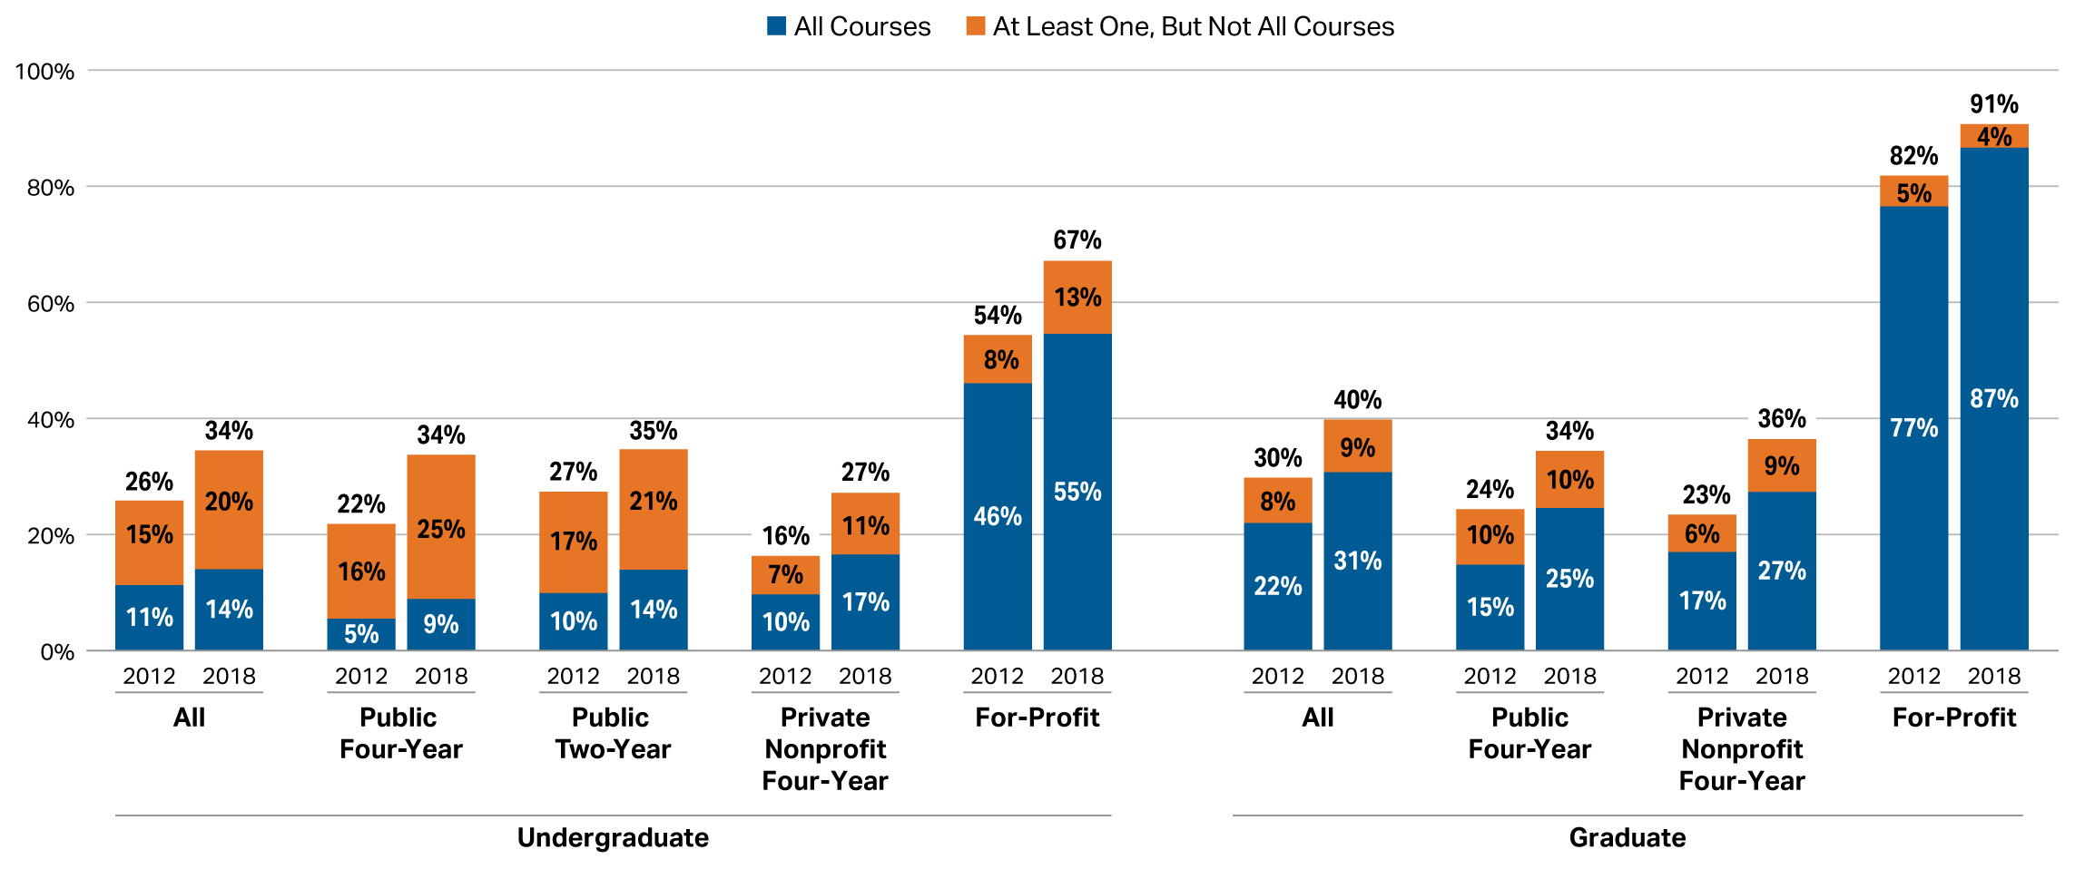
Percentage of Postsecondary Students Enrolled in Distance Education Courses, Fall 2012 and Fall 2018
Source: The College Board, Trends in College Pricing and Student Aid 2020, Figure CP-19.

Slide 29
Thank You.
research.collegeboard.org/trends
trends@collegeboard.org

